Slide 1
Meeting Notes
November 20, 2025

Slide 2
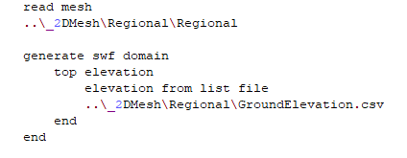

MUT development
Binary mesh save and read subroutines added
Write mesh node and element CSV files for import to QGIS
Final/Initial heads
  When post-processing Modflow outputs final heads are written to a csv file e.g. GWF_FinalHeads.csv
  This can be used to read initial heads for a new run e.g.
  Written Tecplot output could still be used to re-start from intermediate head solutions

Slide 3
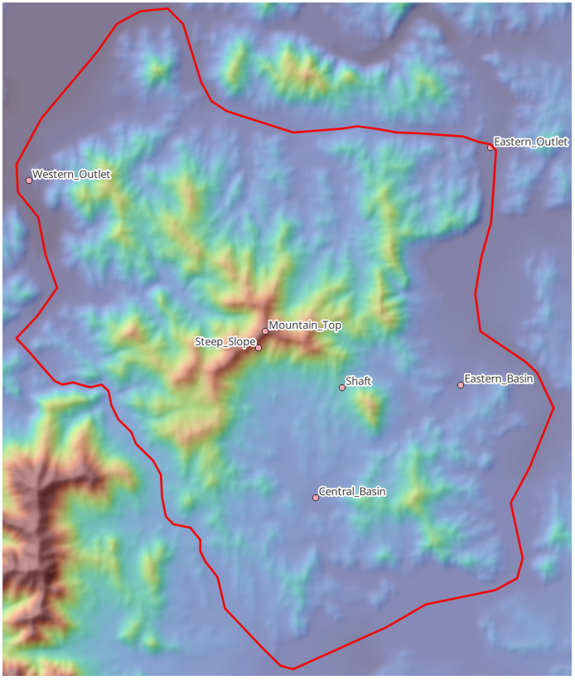
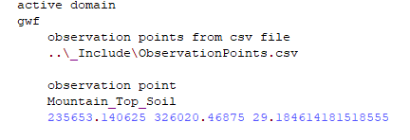
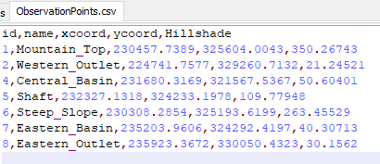
Observation Points

Slide 4
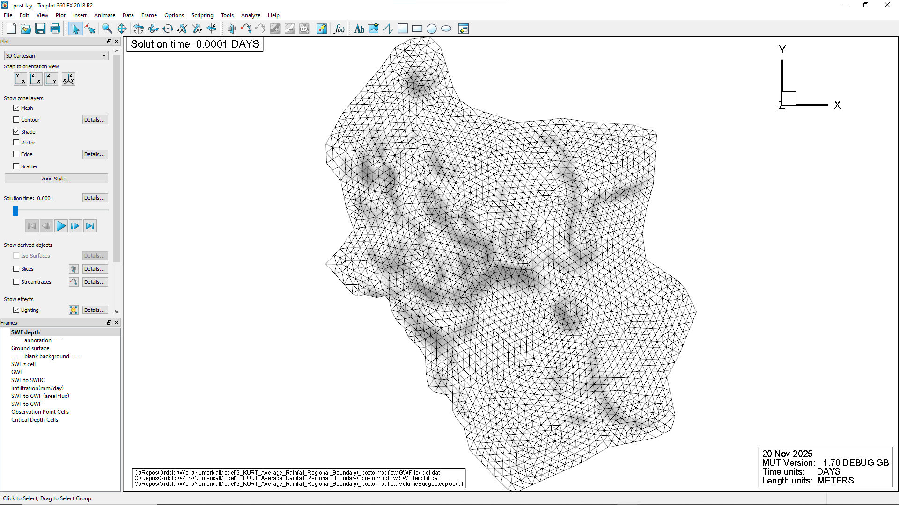
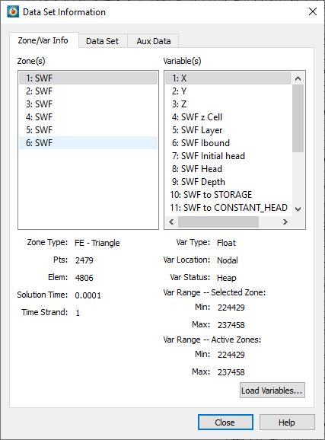

Slide 5
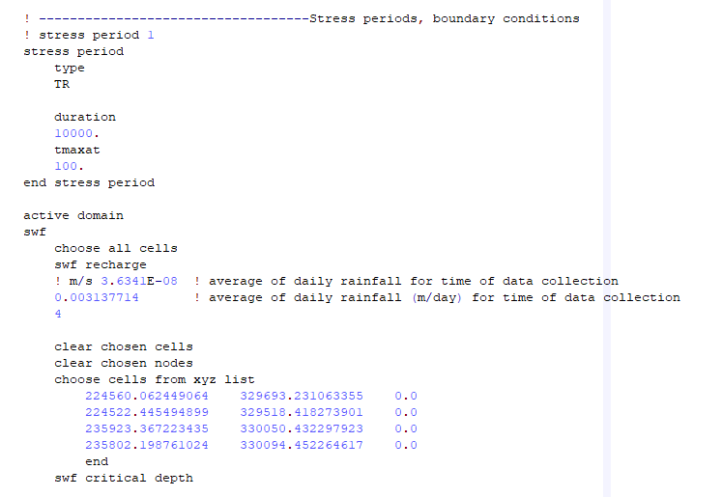
Average Rainfall Spin-up Run

Slide 6
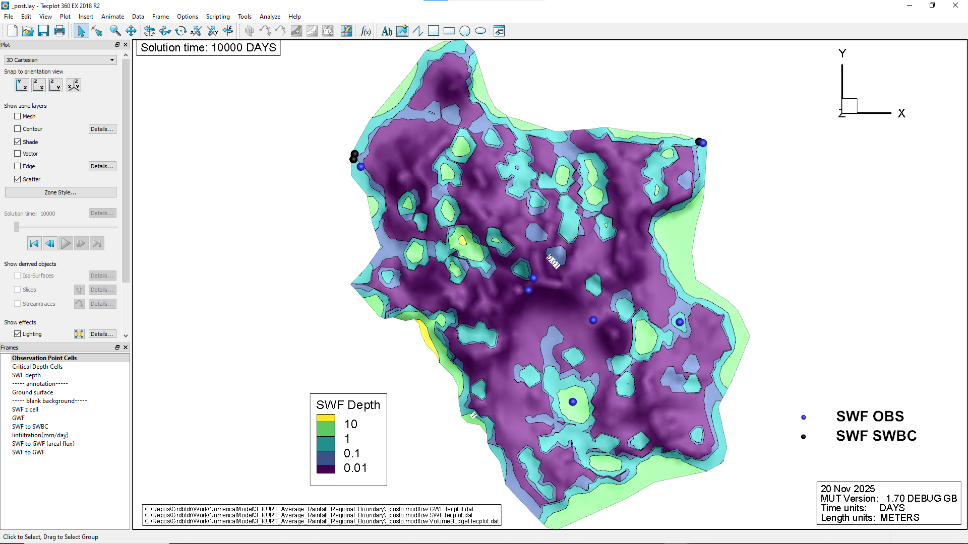

Slide 7
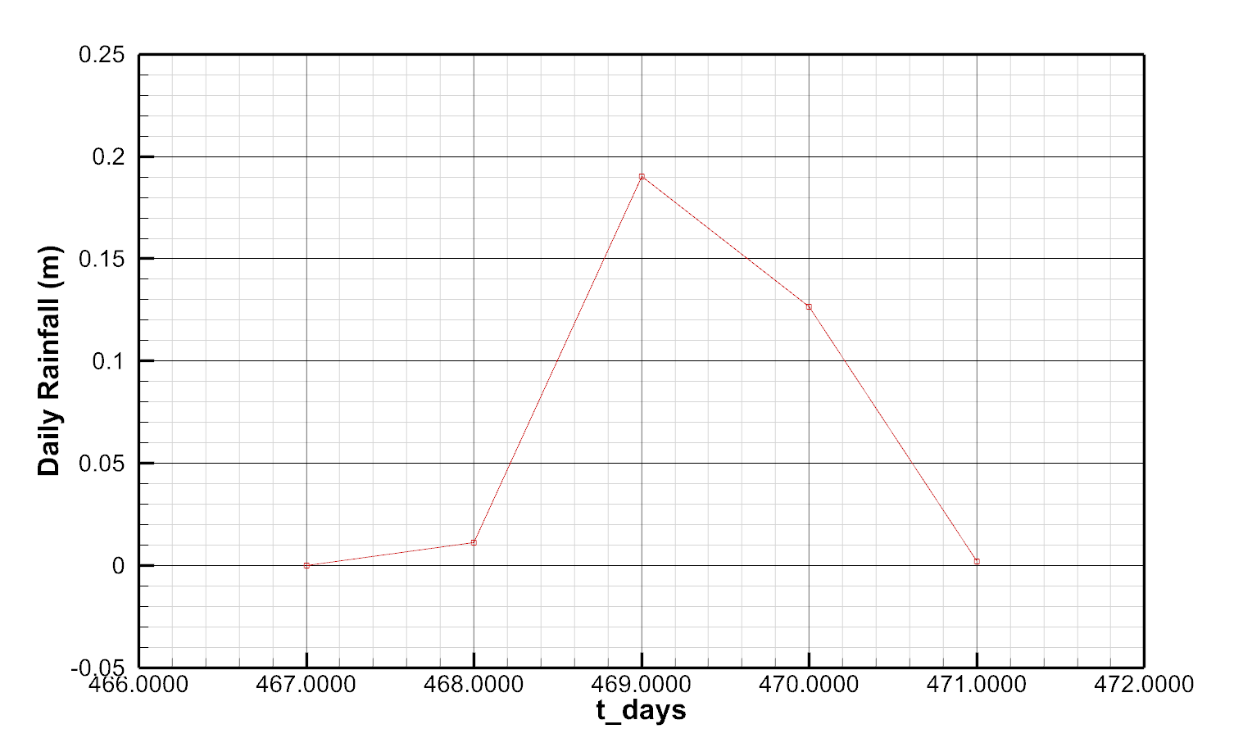
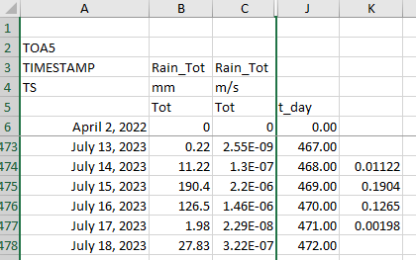
Daily Rainfall Run

Slide 8
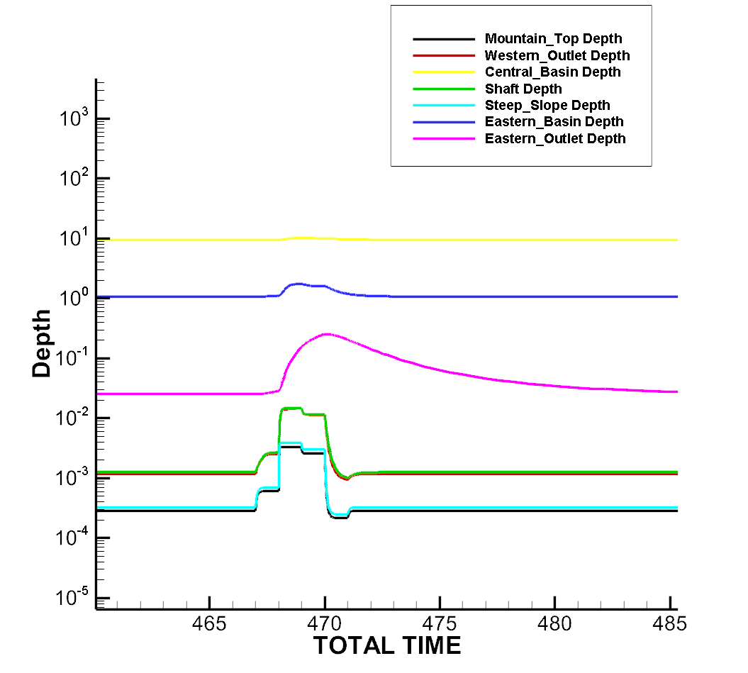

Slide 9
Future work
  CLN version of shaft
  Delaunay and Voronoi mesh generation
  2D Fractures
  Multiple domains

